Slide 1
CS-170 Final Project
Presented by: Ashton Newswanger
Supervised by: Atia Sultana

Slide 2
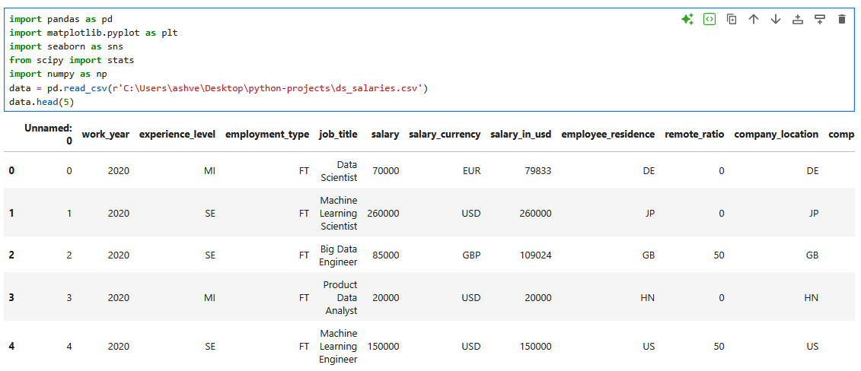
Loading Data & Libraries

Slide 3
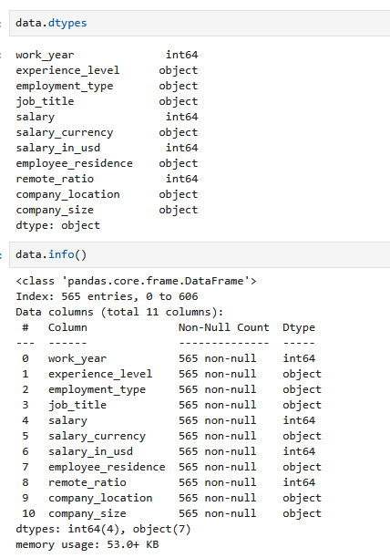
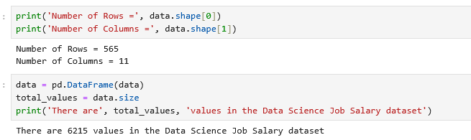
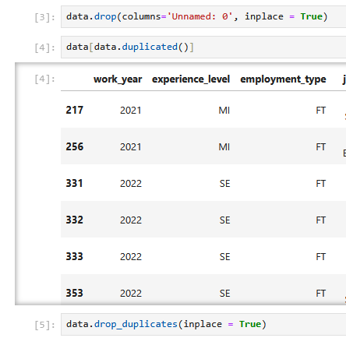
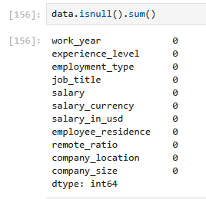
Cleaning & Prepping Data

Slide 4
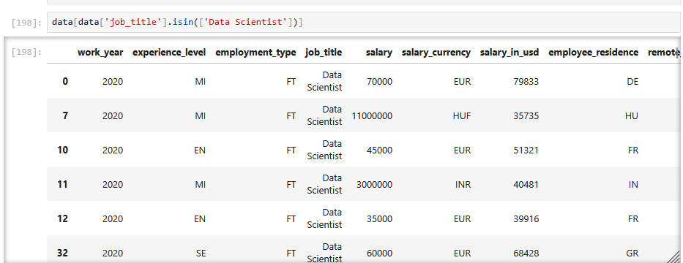
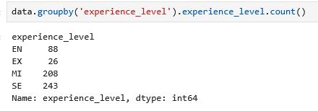
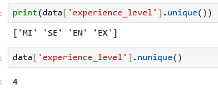
Netflix Project - Is In, Group By, and Unique Count

Slide 5
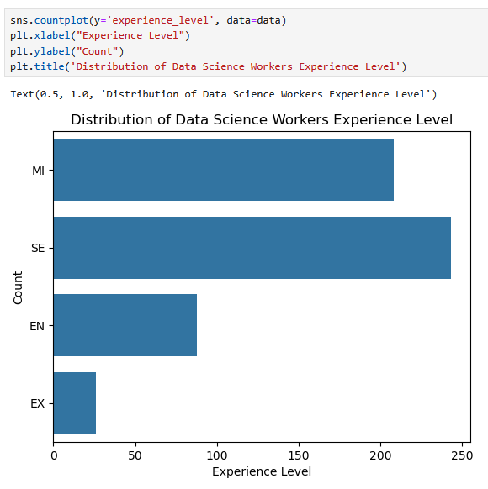
Netflix Project - Bar Charts

Slide 6
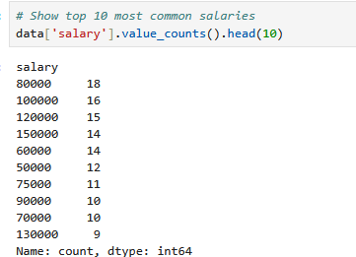
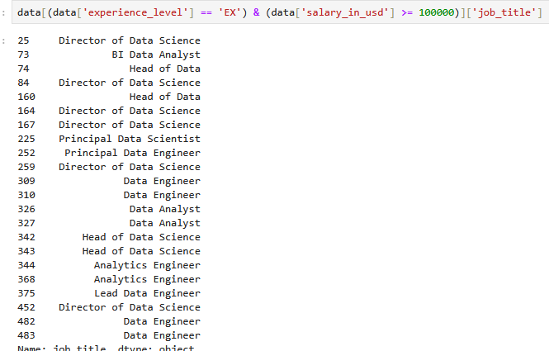
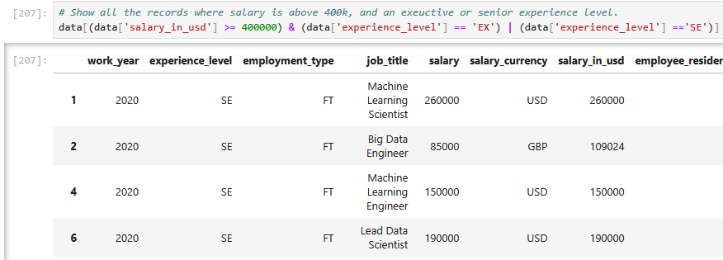
Netflix Project Finding Modes, And & Or Statements.

Slide 7
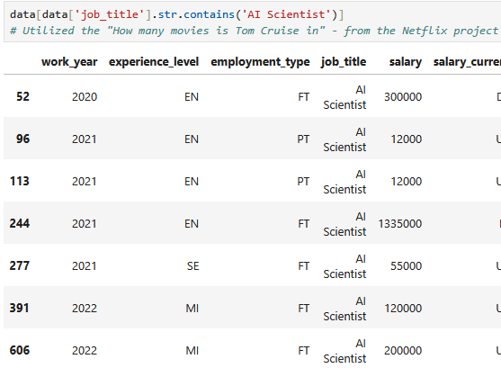
Netflix Project String Contains

Slide 8
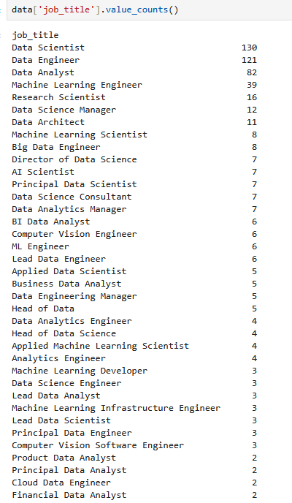
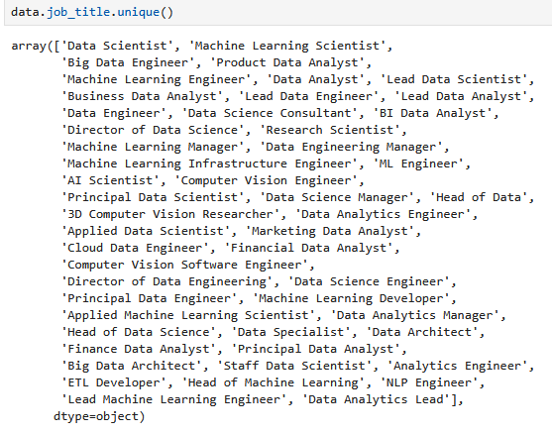

Excel/Sales Data Project – Unique Titles

Slide 9
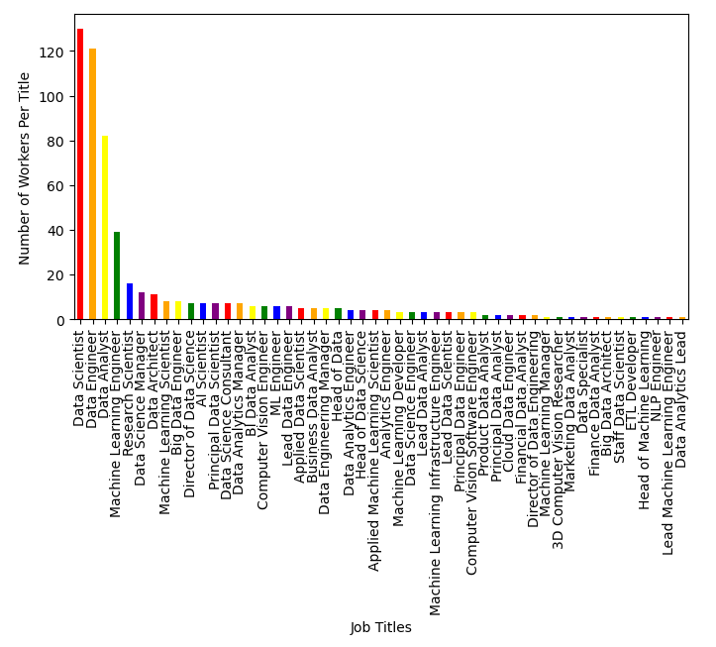
Number of Workers Per Job Title

Slide 10
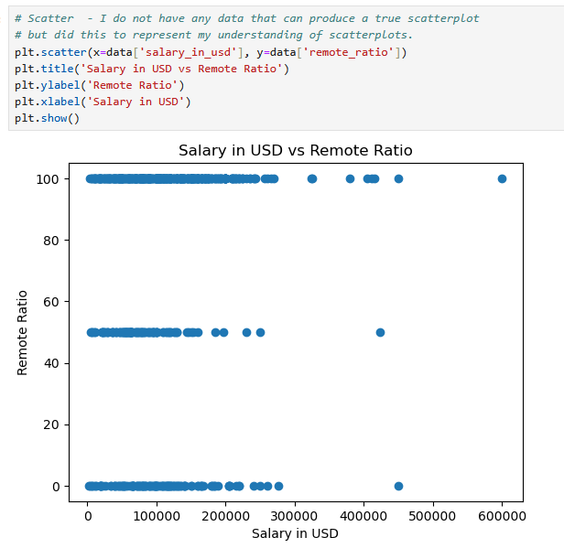
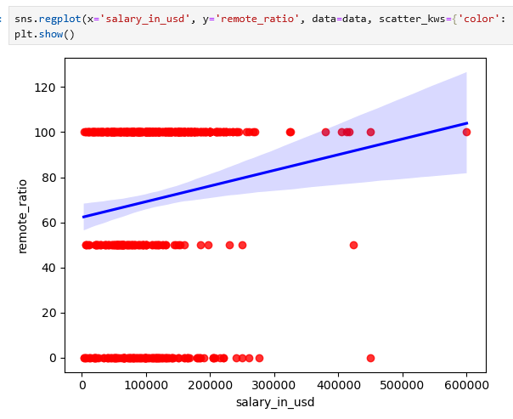
Data Correlation Project – Scatter Plots

Slide 11
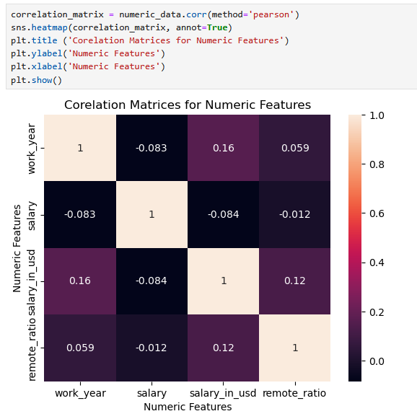
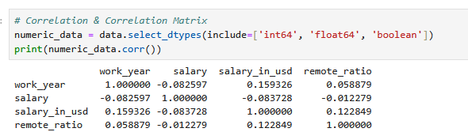
Correlation Matrix

Slide 12
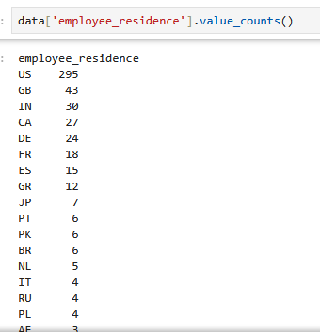
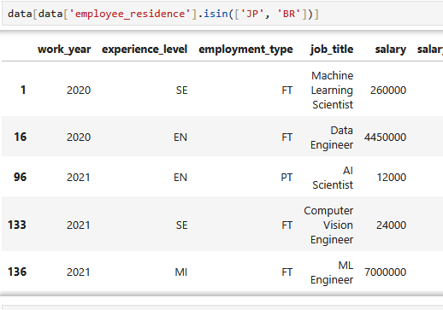
Car Sales Project – Employee Residence

Slide 13
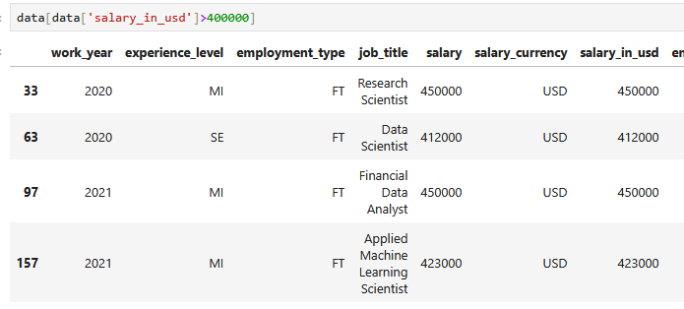
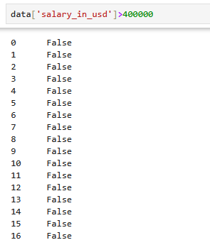
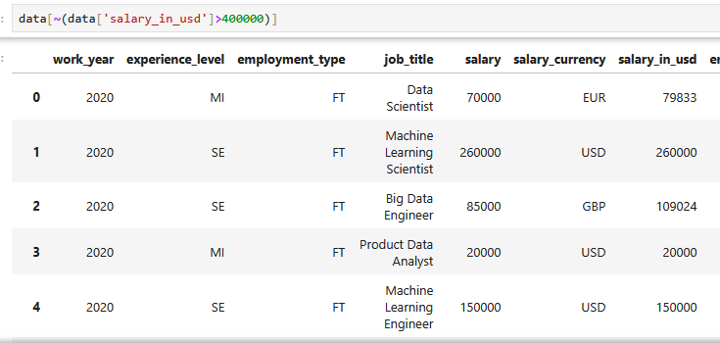
Car Sales Project – Salary in USD

Slide 14
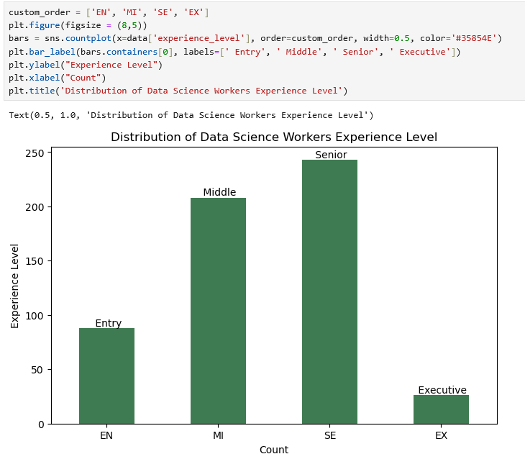
Additional Tasks: Custom Order of Variables, Additional Titles, and Hex Code Colors

Slide 15
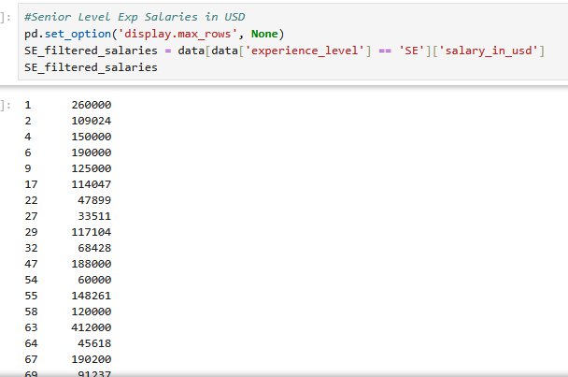
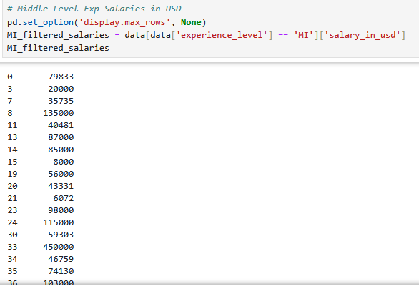
Additional Tasks: T-Test

Slide 16
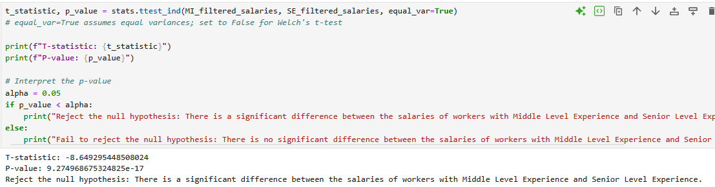
Additional Tasks: T-Test

Slide 17
Conclusion
I utilized in class skills to analyze differing salaries in the Data Science field and added my interest in statistical analysis to the data set by completing a t-test.
Overall, this project gave me a field specific example of utilizing Python for data analysis.
This class helped me understand the basics of Python and how to work with large data sets in Python.
Questions?

